Slide 1
Planar graphs
Jorge A. Cobb
The University of Texas at Dallas

Slide 2
Planar graphs
A graph is planar if it can be drawn on a plane (two dimensions) without any edges crossing
Important applications in layout design
  utility grids (a bipartite graph from the different utilities to the points of consumption)
  circuit board layout (wires must not cross)

Slide 3
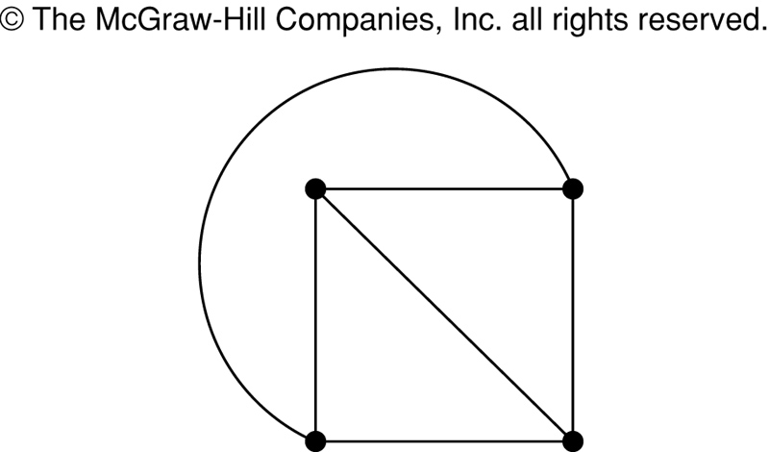
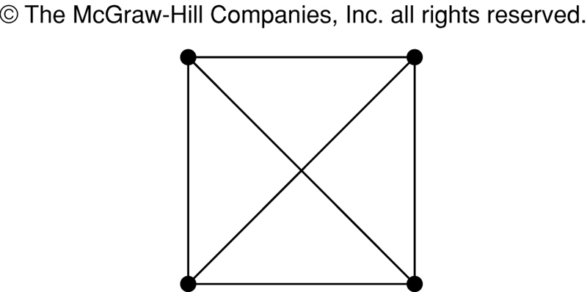
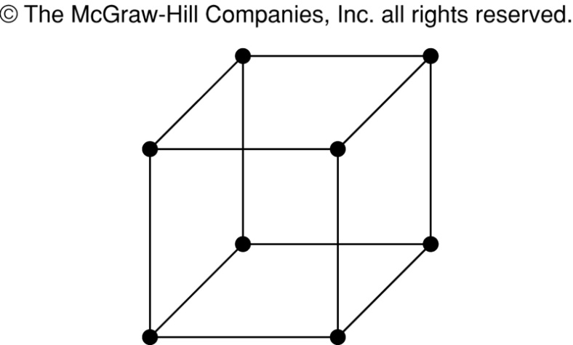
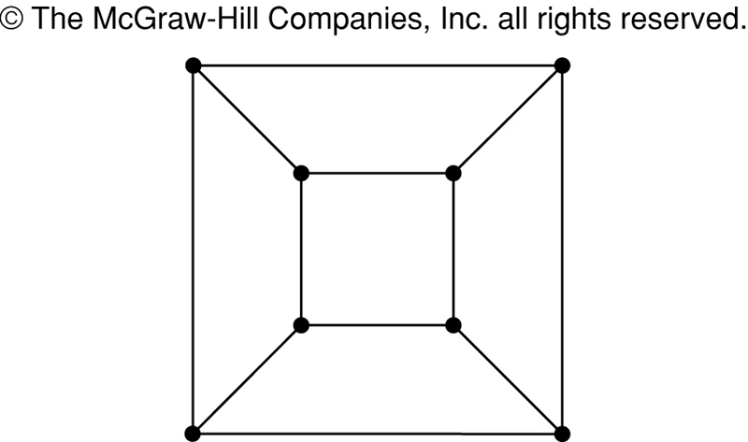
Examples

Slide 4
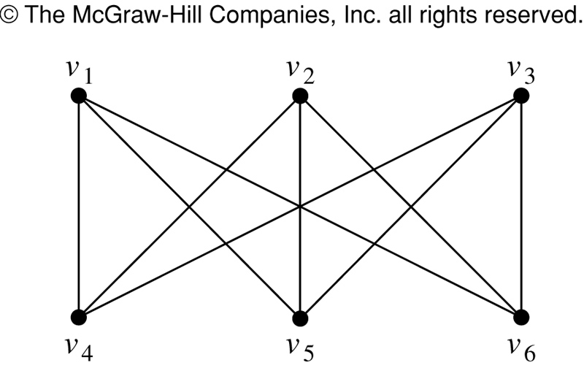
Is K_{3,3} planar?

Slide 5
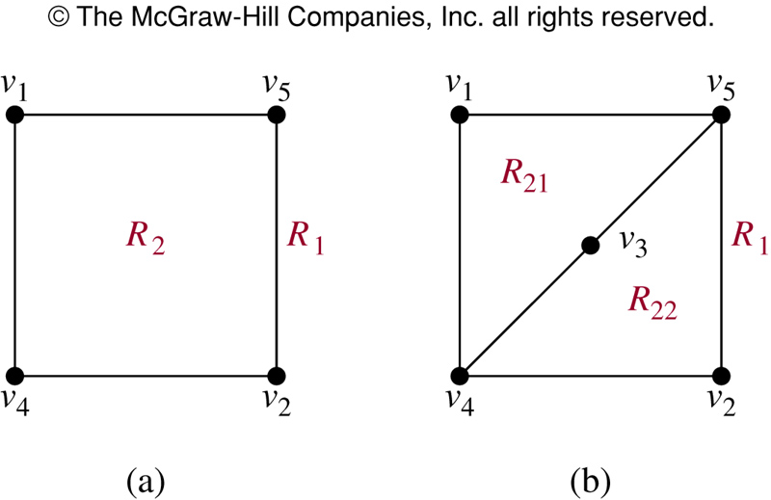
Proof (sketch)
v₆ connects to v₁, v₂ and v_{3,} how to draw v₆?

Slide 6
Proof (sketch)
Let {1, 2, 3} and {4, 5, 6} be the two sets of vertices. Consider first the vertices 1, 2, 4, 5. These vertices must form a closed square (since 1 connects to 4, 5, and so does 2).
Now consider 3. Suppose it is inside the square. Then we have three regions: two triangles, and the outside of the square. No matter where 6 is placed, edges from it will cross existing edges. The analysis is similar if 3 is outside the square.
The same procedure can show that K5 is not planar.

Slide 7
Euler’s Formula
Theorem: Let G be a connected planar simple graph with e edges and v vertices. Let r be the number of regions in a planar representation of G. Then r = e – v + 2.
  Proof is in the book.
Corollary 1: If v ≥ 3, then e ≤ 3v – 6
  Proof given later
Corollary 2: G has a vertex of degree 5 or less
  This follows from corollary 1

Slide 8

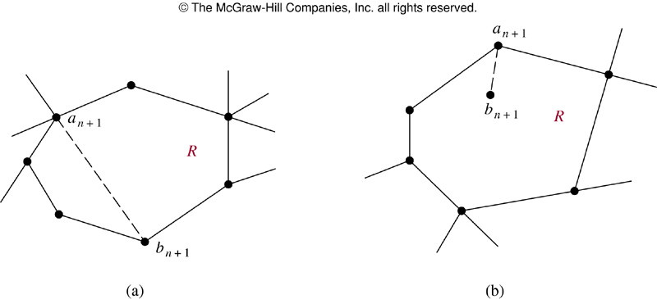
r = e – v + 2.

Slide 9
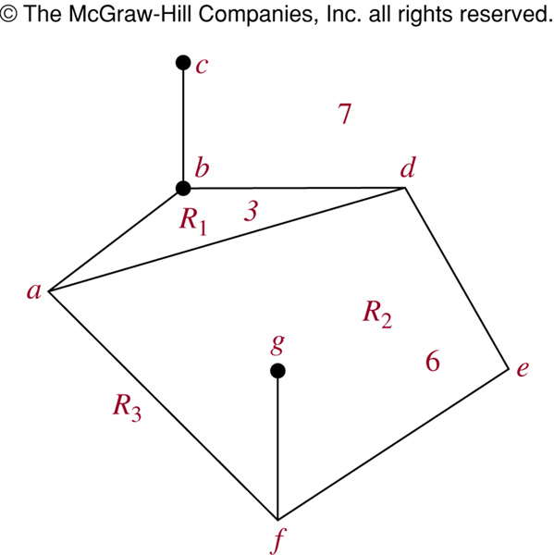
Degree of a region
Number of edges in the border
  Edges with pendant nodes count twice.

Slide 10
Proof of corollary 1.
Corollary 1: if v ≥ 3 then e ≤ 3v – 6
  The degree of each region is at least 3.
    Recall that the graph is simple (no self-loops, or multi-edges between nodes)
    For a region to have degree only 2, it must be a single edge, but v ≥ 3.
  Sum of the degree of regions is 2e
    Every edge touches two regions, one on each side of it
  2e = Sum degrees ≥ 3r = (Euler’s) 3e – 3v + 6
  Using algebra, we get
    e ≤ 3v – 6

Slide 11
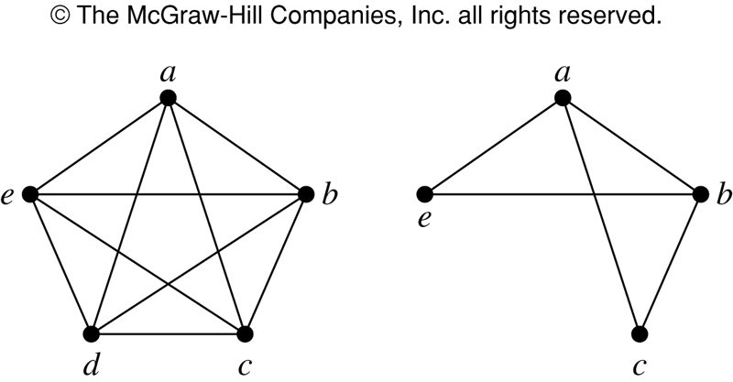
K₅ not planar
v = 5, e = 4 + 3 + 2 + 1 = 10
e ?≤? 3v – 6

Slide 12
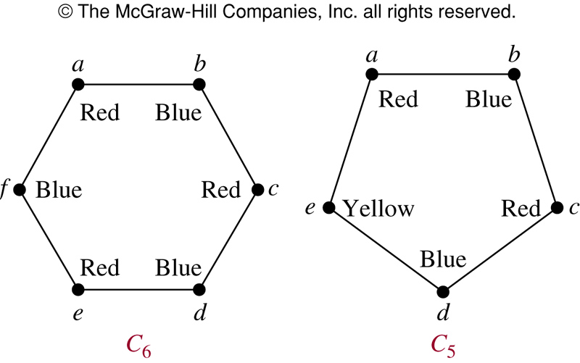
Graph coloring
How many colors do you need if you assign a color to each vertex, and no two neighbors have the same color?

Slide 13
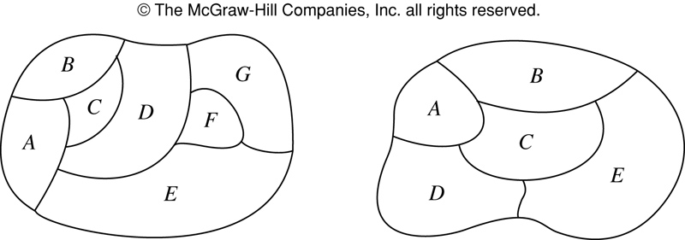
Planar Graphs
Thm: A planar graphs requires only 4 colors
Maps, are planar graphs!
  You only need four colors.

